Slide 2
Materials
- Copy of “True Diary…”
- Composition notebook
- Pen or pencil
- Part-Time Self project
- “This I Believe” project
- Literary Analysis project packet
- Independent Reading Book

Slide 3
Talkless text
Take out your book and begin reading (remember 10,000 hours of practice = expert)
If you need a book, show the number of the library you wish to visit.

Slide 4
COLLECTOR
Your mission is clear:
Collect Part-Time Self and “This I Believe” projects
Check off who has turned it in

Slide 5
Soccer Tryouts
Boys:
Oct 4th, 5th and 6th
from 4:30 to 6
Girls:
Oct 5th and 6th
from 4:30 to 6
Both will be at Anza Elementary.

Slide 6
SLC Preparation
Handout: SLC Logistics

Slide 7
SLC Preparation Work Time
Deliverables:
- Complete SLC “Grade and Evidence Analysis”
- Organized blue folder including:
- “Lamb…” essay and rubric
- Grade and Evidence Analysis sheet
- SLC Logistics handout (back TBC after SLC)
- All evidence for Literary Analysis by Tuesday EOD

Slide 8
SLC Preparation Work Time
IMPORTANT:
Is your SLC tonight?? If so, put your Literary Analysis packet in your blue folder so you can compare your current work to your previous “Lamb…” essay during your SLC

Slide 9
Materials
- Copy of “True Diary…”
- Composition notebook
- Pen or pencil
- Literary Analysis project packet
- Projects (if you’re turning them in late)
- AGENDA

Slide 10
Reflective Writing 10/4/2016
Imagine that you fell down a mine shaft with nothing more than a pair of extra socks, some dental floss, a mini-flashlight, a bag of pretzels, and a set of keys. You managed to survive for two days and then freed yourself.
In three to five paragraphs, tell the story of how you escaped. Try to create a suspenseful mood for your story.

Slide 12
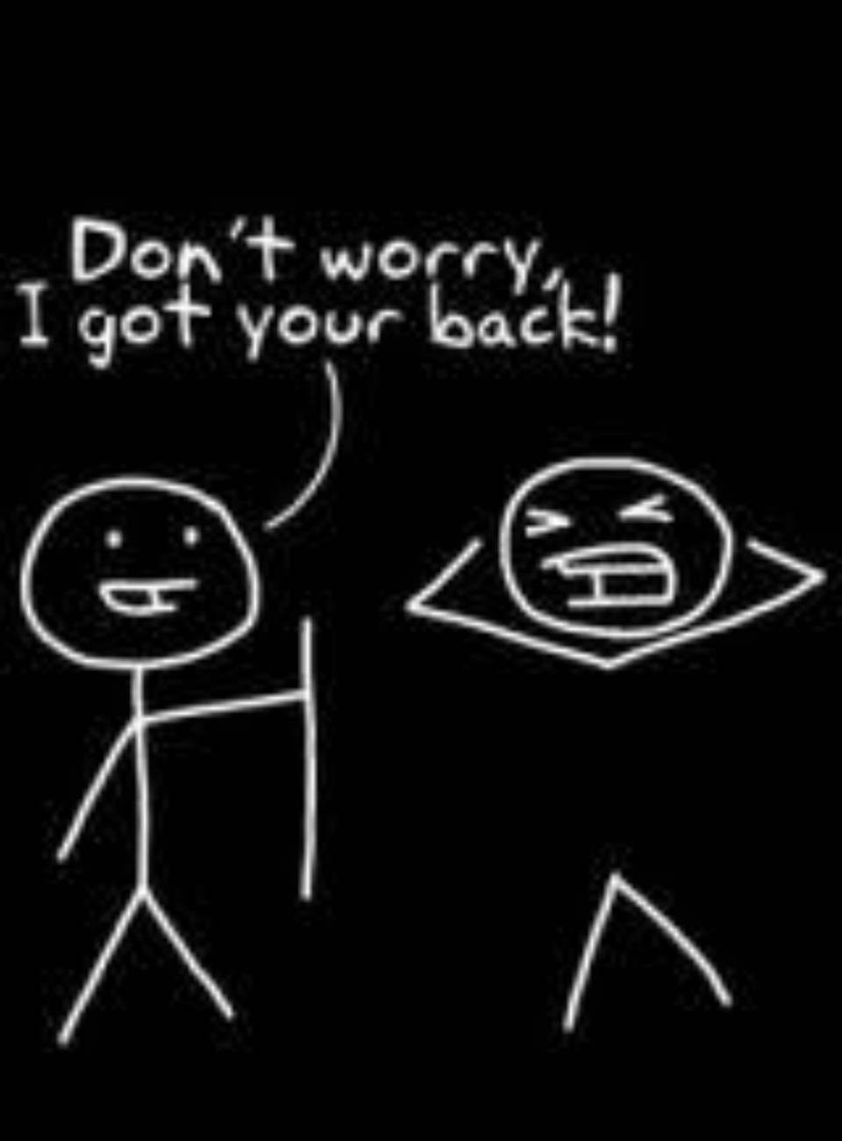
Advice from SLCs?

Slide 13
Start Something that Matters
Needs to be in your hands before
October 10
If you will need a copy to borrow, you
must stay after class to talk to me

Slide 14
Literary Analysis
Thesis: Junior becomes a more confident, self-assured person as a result of the many challenges he faces while growing up. The author demonstrates this changes through the use of dialogue, character thoughts, and character actions.
Assertion: At the start of the novel, Junior lacks confidence as a result of the way others treat him because of his disability. The author reveals this through Junior’s thoughts.
Evidence:
A. Junior reflects on his disability, thinking, “My brain damage left me nearsighted in one eye and farsighted in the other, so my ugly glasses were all lopsided because my eyes were so lopsided” (Alexie 3).
B. Junior reflects on his life, thinking, “My head was so big that little Indian skulls orbited around it. Some of the kids called me Orbit. And other kids just called me Globe. The bullies would pick me up, spin me in circles, put their finger down on my skull, and say, ‘I want to go there’” (Alexie 3).

Slide 15
Notes 10/4/2016 Evidence
- Every paragraph needs _________ pieces of evidence
- Each piece of evidence needs to ___________ your assertion
- Each piece of evidence must be _______________ and
______________

Slide 16
Notes 10/4/2016 Evidence
Notice the placement of commas, quotes, periods, and parenthesis.
The author states, “This is how to correctly cite evidence” (LastName #).

Slide 17
At the start of the novel, Junior lacks confidence as a result of the way others treat him because of his disability. The author reveals this through Junior’s thoughts. Junior reflects on his life, thinking, “My head was so big that little Indian skulls orbited around it. Some of the kids called me Orbit. And other kids just called me Globe. The bullies would pick me up, spin me in circles, put their finger down on my skull, and say, ‘I want to go there’” (Alexie 3).
Assertion
Evidence Tag
Correctly cited evidence

Slide 18
Deliverable
All evidence must:
- Be correctly cited
- Be adequate in amount for each paragraph
- PROVE your assertion
Finished early? Start typing your outline!

Slide 19
Clean up
Is your SLC tonight? Please put your Literary Analysis packet in your blue folder before you leave!

Slide 21
Materials
- Copy of “True Diary…”
- Composition notebook
- Pen or pencil
- Literary Analysis project packet
-Agenda

Slide 22
Reflective Writing 10/6/16
Are you on track to complete your essay by Monday? Why or why not?
Have you completed your evidence and analysis for every paragraph?
Notes:
Students will read independently for 20 minutes. Use this time to take attendance.

Slide 23
Notes 10/5/2016
Analysis
- Analysis has two jobs:
1. Explain the meaning of the evidence
2. Describe how the evidence PROVES the assertion
- That means the analysis for each piece of evidence is two sentences or more

Slide 24
Notes 10/5/2016
- How will I remember this???? Think: SAY, MEAN, MATTER
- SAY: Write your evidence (quoted and cited)
- MEAN: What does this evidence mean?
- MATTER: Why does this evidence matter? How does it
prove my assertion?

Slide 25
Notes 10/5/2016
For example:
Junior reflects on his life, thinking, “My head was so big that little Indian skulls orbited around it. Some of the kids called me Orbit. And other kids just called me Globe. The bullies would pick me up, spin me in circles, put their finger down on my skull, and say, ‘I want to go there’” (Alexie 3). Here the author describes how Junior’s peers bully him because of his appearance. Junior internalizes this negativity and believes that what the bullies say is true. This causes Junior to lack confidence in himself just because of the way others are treating him, not because of his actual abilities.
SAY
MEAN
MATTER

Slide 26
Notes 10/5/2016
- Analysis is your critical thinking
(your words, your thoughts)
- Remember to PROVE your argument – DO NOT summarize
- SAY, MEAN, MATTER

Slide 27
Literary Analysis
- Introduction
- Conclusion

Slide 28
Literary Analysis
Deliverable:
- Complete draft of your Literary Analysis essay by tomorrow (Friday)

Slide 29
Tomorrow
- Read independently
- Independent edits
- Partner edits
- Work time to implement revisions
Essay is due Monday, October 10th (printed and stapled to rubric!)

Slide 30
Clean up
Is your SLC tonight? Please put your Literary Analysis packet in your blue folder before you leave!

