Slide 1
THE SETLIST

Slide 2
THE SETLIST

Slide 3
The Setlist challenge
Some say the music industry today shapes the world around us whether we want it to or not. It is evident in the coffee shops we visit, the malls we shop in, and the Spotify tracks we scour. As design thinkers and learners, we want to make sure that we are relevant in creating music that generates revenue and pushes the limits of the industry, yet also builds positive culture around us and designs the world we want to live in. Not only is your challenge to research and discover progressive music in the industry, but also to be a part of writing lyrics that can make a difference just the same.

Slide 4
Driving question
How can we design lyrics that have a positive message in the music industry?
How can we positively affect the music industry, even though we aren’t super famous pop stars?

Slide 5
Essential Skills
Thesis
Evidence
Literary Analysis:
Figurative Language
Tone

Slide 6
Individual Deliverables
Artist’s Journal: song lyrics, annotations & edits, feedback, drawings, poetic word lists, etc.
Socratic Seminar preparation and contribution
Song Lyrics: written, edited, annotated, recorded and published
Explication of Song Lyrics

Slide 7
Group deliverables
Record Label Research
Letter & Picture to Record Label
Group Collaboration Evaluations

Slide 8
THE SETLIST An exploration of the music industry.
Individual Lyrics Rubric
 | 4 | 3 | 2 | 1
Literary Analysis | Tone, imagery
Word Choice & Vocabulary | connotation
Thesis | theme
HOM Quality: Song Format | Versus, chorus, bridge
The challenge
Some say the music industry today shapes the world around us whether we want it to or not. It is evident in the coffee shops we visit, the malls we shop in, and the Spotify tracks we scour. As design thinkers and learners, we want to make sure that we are relevant in creating music that generates revenue and pushes the limits of the industry, yet also builds positive culture around us and designs the world we want to live in. Not only is your challenge to research and discover progressive music in the industry, but also to be a part of writing lyrics that can make a difference just the same.
The driving question
How can we design lyrics that have a positive message in the music industry?
Group Letter to Label Rubric
 | 4 | 3 | 2 | 1
Thesis | Has a clear, thorough and consistent persuasive argument throughout essay. | Has a clear persuasive argument throughout. | Has a vague thesis statement or is not consistent. | Has no thesis statement.
Evidence | Evidence strongly and adequately supports thesis, with proper citations. | Evidence generally supports thesis. | Evidence does not support thesis or is not adequate. | Has no evidence.
Word Choice & Vocabulary | Utilizes industry terminology and powerful word choice to strengthen argument and build credibility with targeted label (audience). | Utilizes some industry terminology and word choice is clearly engaging. | Utilizes little industry terminology and word choice is somewhat engaging | Utilizes no industry terminology and word choice is not engaging.
HOM Quality: MLA | Has professional business letter format (singles paced and aligned left) including Sender’s Address, RE:, Date, Greetings, Body, Salutations, and Contact. | Has business letter format, but includes 1-2 spacing or alignment issues. | Has business letter format but Includes 3-4 spacing or alignment issues. | Has no business letter format or more than 5 issues.
The deliverables
Individual:
Artist’s Journal: song lyrics, annotations & edits, feedback, drawings, poetic word lists, etc.
Socratic Seminar preparation and contribution
Song Lyrics: written, edited, annotated, recorded and published
Explication of Song Lyrics
Group:
Record Label Research
Letter & Picture to Record Label
Group Collaboration Evaluations

Slide 9
Freedom of speech Article
INDEPENDENTLY: Read article and create a PAPA square, analyzing the
Purpose of the article
Argument of the article
Persona of the author
Audience
Center Box: 3 quotes that support your position

Slide 10
Freedom of speech Article
Counterargument:
Identify and analyze the opposing argument/evidence
Find the fault in their logic
Challenge with your own evidence
Practice: The sky is blue.

Slide 11
Freedom of speech Article
Counterargument:
Identify and analyze the opposing argument/evidence
Find the fault in their logic
Challenge with your own evidence
Practice: Walking under ladders is bad luck.

Slide 12
Freedom of speech Article
COLLABORATIVELY:
Discuss the one argument from the opponent [in the article].
Challenge and present your counterargument with evidence.
Prepare your 1) counterargument and 2) evidence from the article.

Slide 13
Billboard TOP 40’s
Looking at the music in this ranking, discuss and identify characteristics that make music positive and/or negative.
Collaboratively, separate the TOP 40 into “Positive Content” and “Negative Content.”
Using math, create a comparative statistic and a recommendation for what we should do with the negative music, since we live in “Freedom of Speech.”

Slide 14
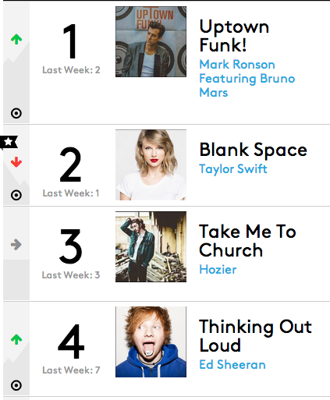
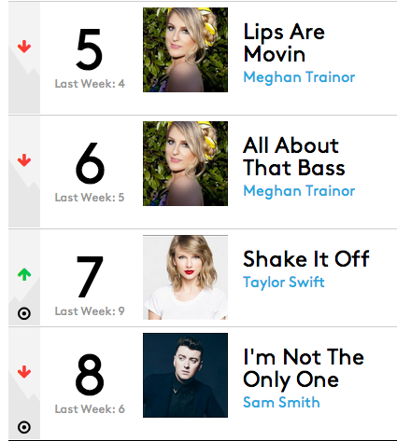

Slide 15
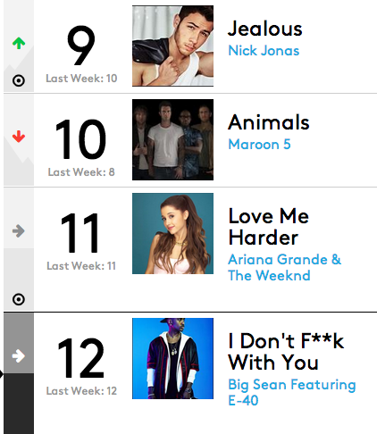
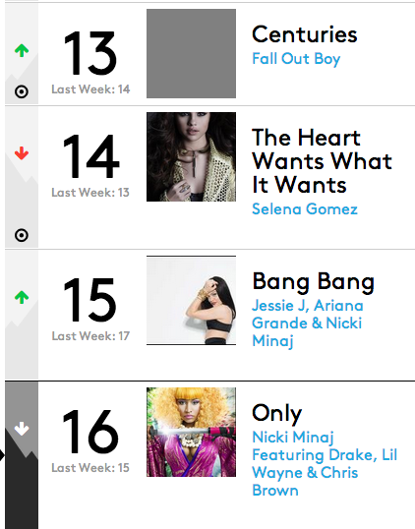
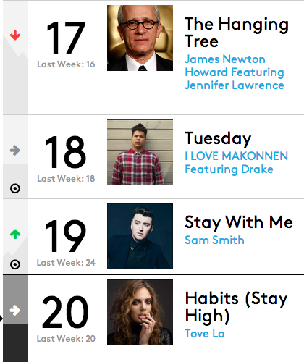
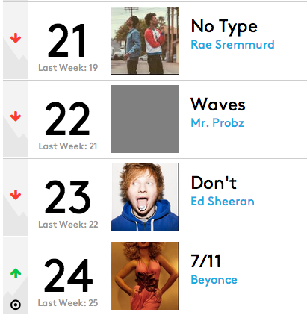
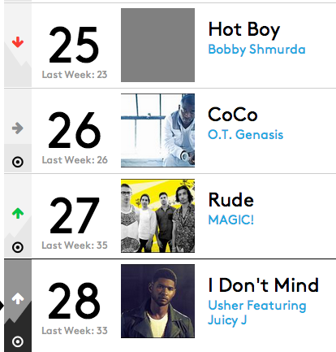
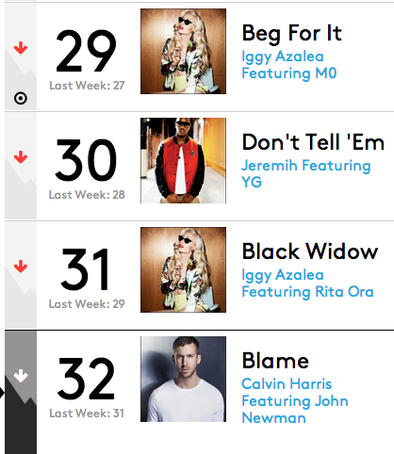
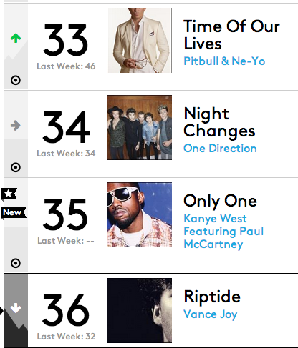
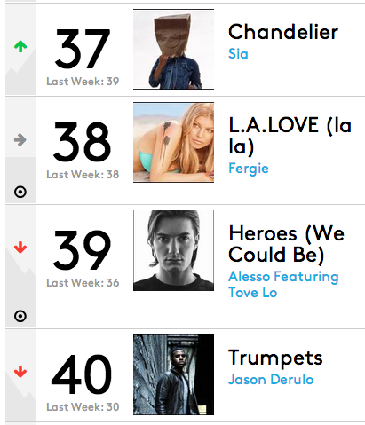
TOP 40’s Analysis
Looking at the music in this ranking, discuss and identify characteristics that make music positive and negative.
Collaboratively, separate the TOP 40 into “Positive Content” and “Negative Content,” creating a visual poster to present to the class.
Using math, create a comparative statistic and recommendation for what we should do with the negative music, since we live in “Freedom of Speech.”

Slide 16
TOP 40’s Analysis
Credits
Recorder
Reporter
Researcher
Mathematician
Positive Content
Negative Content
Has lyrics that are happy, about resilience, encouraging positive actions, or social change.
Song Title
Song Title
Song Title
Has lyrics that objectify women or minorities, value money over relationships, or suggests sex out of commitment, drugs use, or murder.
Song Title
Song Title
Song Title
82% of all the songs on the Top 40’s have negative content. We recommend that these songs should not be played at school dances.

Slide 17
Tone
Tone is the author’s attitude to a topic.
The author’s tone is expressed through the words or details he or she selects.
Text Books use an objective tone
Objective: matter-of-fact, neutral
Poems use a subjective tone
Subjective: personal, based on emotion, biased

Slide 18
Tone:… what changed?
Mother Teacher
Sister Best Friend

Slide 19
Tone
DIDLS
Diction: author’s word choice
Imagery: pictures and figurative langauge created (comparisons)
Details: information given vs. omitted
Language
Syntax

Slide 20
Tony’s Place is crammed into a tiny building next to the Fine Arts Theater. The owners offer a menu of Italian food. They’ve got the checkered table clothes, dim lights, and crusty bread. They also know how to make a hearty red sauce. Too bad they use it to drown delicate fish. They also seem to lace everything with truckloads of garlic. The service needs some work, too. Our waiter didn’t know what the specials were. Nor did he think to refill our water glasses before we asked. With a combination of fake-friendly chatter and outright nagging, he made us order, finish up, and clear out. He seemed to see us only as automatic tip machines. The food and low prices bring the customers in the door. The service should not push them out.

Slide 21
Mini Quiz
1. The tone of the passage is
a. sad. c. plain and factual.
b. boastful. d. critical, or finds fault.
2. The writer says, “He seemed to see us only as automatic tip machines.” The tone of this sentence is _____________ because…

Slide 22
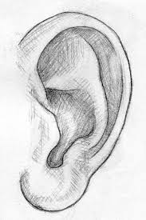
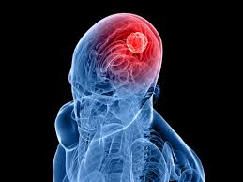
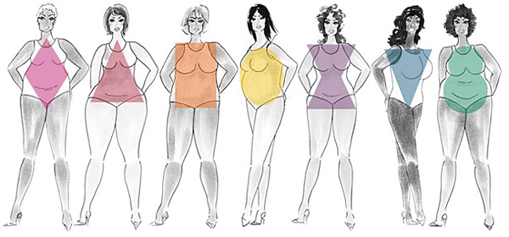
Poetic devices
FORM and purpose
AUDITORY
COGNITIVE

Slide 23
Auditory devices
Auditory = what you hear
How does what you hear affect the TONE?
Rhythm
Rhyme

Slide 24
explication
Root Word: Explicate
V. To clarify, to illuminate, to expose
Write an explication that clarifies and exposes the poem’s meaning.
Give details to demonstrate HOW the author creates that meaning figuratively.

Slide 25
How to Explicate Poetry

Slide 26
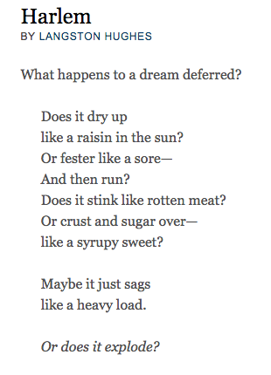
Unearthing Meaning
Title:
Patterns:
Auditory:
Cognitive:
Literal:
Figurative:

Slide 27
Rhythm
Pattern of stresses within a sentence.
Stressed vs. Unstressed
Foot = number of syllables
Iambic = unstressed followed by a stressed
Trochaic = stressed followed by unstressed
Dactylic = 1 stressed followed by 2 unstressed
Anapestic = 2 stressed followed by 1 unstressed
Free Verse = no metric and no rhythm
Blank Verse = metric by no rhythm
https://www.youtube.com/watch?v=IhzGjc6qBWQ
Honors: Part 3 on the Writing Lyrics Post on Weebly

Slide 28
Rhythm
Pattern of stresses within a sentence.

Slide 29
Rhythm "Thinking Out Loud" by Ed Sheeran
(AUDITORY) Rhythm Explication
By looking at the lyrics of ____________________’s song,
“_____________________, ” the author uses a __________
(upbeat, downbeat, slow, fast-paced) rhythm to convey a ___________
tone. This is an important tool in creating a _________ mood, as the audience feels _____________________________________________. In
Lines, “________________________________________________
_________________________________________________” (_____________artist, _______line), it further expresses the author’s idea that __________________________________________________________________________.

Slide 30
Rhyme
Rhyme https://www.youtube.com/watch?v=gYa36pKCHkQ
Develop a 4 line rap
Flocabulary: Flow Dictionaryhttp://www.flocabulary.com/rap_rhyming_dictionary/
Rap Beat: https://www.youtube.com/watch?v=KZKeH5k4JMU

Slide 31
Rhyme
Rhyme is the the matching sounds of the middle or end of two or more words.
Balloon + Soon
Say +
Floor +
Obsession +

Slide 32
Rhyme
Rhyme Scheme is the pattern of Rhymes in a poem:
A B C D E...https://www.youtube.com/watch?v=gYa36pKCHkQ
Develop a 4 line rap that has an A B A B rhyme
Flocabulary: Flow Dictionaryhttp://www.flocabulary.com/rap_rhyming_dictionary/
Rap Beat: https://www.youtube.com/watch?v=KZKeH5k4JMU

Slide 33
Rhythm & Rhyme Quiz — tmrw)
Annotate Poem + mark rhythm and rhyme
Identify key terms
Answer multiple choice questions about rhythm and rhyme in the poem
Write about rhythm and rhyme and affect on tone
Practice Quiz

Slide 34
Sonnet 130 by William Shakespeare
My mistress' eyes are nothing like the sun; Coral is far more red than her lips' red; If snow be white, why then her breasts are dun; If hairs be wire, black wires grow on her head. I have seen roses demask'd, red and white, But no such roses see I in her cheeks; And in some perfumes in there more delight Than in the breath that from my mistress reeks. I love to hear her speak, yet well I know That music hath a far more pleasing sound; I grant I never saw a goddess go; My mistress, when she walks, treads on the ground; And yet, by heaven, I think my love as rare As any she belied with false compare.

Slide 35
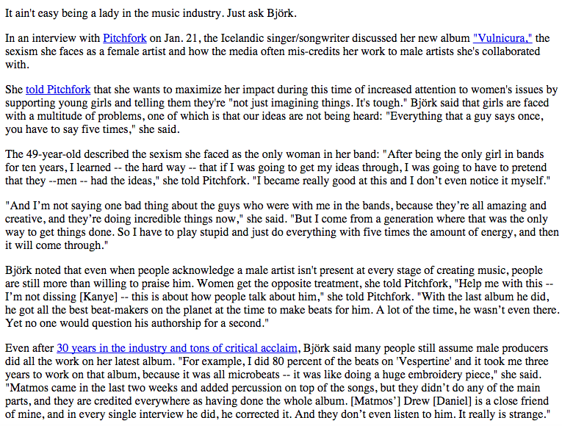
Bjork on sexism in the music industry by Alanna Vagianos – The Huffington Post

Slide 36
Socratic Seminar Preparation
Directions:
Annotate and understand (PAPA)
Purpose
Argument
Persona
Audience
Pick a Quote with a STAR *
Ask a Question: How or why ___________?

Slide 37
PARALLEL STRUCTURE
SENTENCE STRUCTURE
PARALLEL
STRUCTURE
The organization and format of a sentence with multiple .
A sentence is made of a SUBJECT & PREDICATE.
Ms. Vance is awesome because she is.
(NOUN) (VERB)
Using the same format when creating a list.
Ms. Vance is awesome because she is hilarious, kind and talented.
(ALL ADJECTIVES)

Slide 38
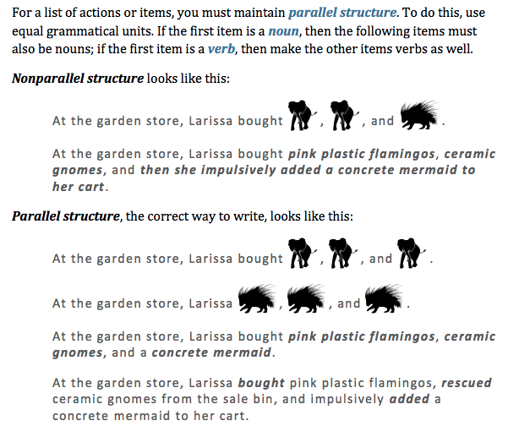
PARALLEL STRUCTURE
PARALLEL
STRUCTURE

Slide 39
NOTES: PARALLEL STRUCTURE
PARALLEL
STRUCTURE
GERUND
Vs.
PARTICIPLE
NOT PARALLEL = mixed adjectives, verbs and nouns.
Ms. Vance is awesome because she is hilarious, makes it rain and goes shopping everyday.
(NOT ALL ADJECTIVES
PARRALLEL STRUCTURE doesn’t mix tenses or gerunds/participles.
GERUND = -ing verbs (running, jumping, singing)
PARTICIPLE = to verbs (to run, to jump, to sing)
Past Participle = -ed verbs (ran, jumped, sang)

Slide 40
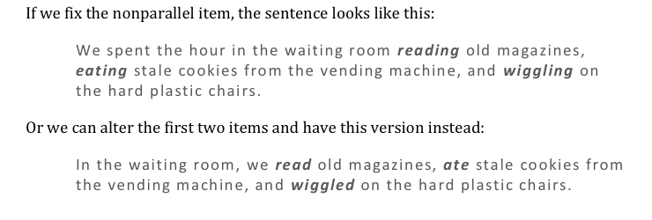
FIXING PARALLEL STRUCTURE

Slide 41
practice
Exercise 3 (finish with your partner)
Homework:
Independent Practice: Exercise 1 or 5 (get link on Weebly) and record all answers on a separate piece of paper to turn in. Record # of correct/total.
10/20

Slide 42
PARALLEL STRUCTURE Quick check
Record full sentences.
A bathroom sink filled with hair, counter surfaces piled with paper and books, and _______ dissuaded Beverly from sharing the apartment with Tina.
To make his weight class for the wrestling match, Bart slipped diet soda, nibbled carrot sticks and _____.
The presence of a vampire, a space alien, or _____ will make Noreen reject a movie.

Slide 43
Positive <------TONE------> Negative
Smart

Slide 44
Positive <------TONE------> Negative
Resourceful

Slide 45
Positive <------TONE------> Negative
Wise

Slide 46
Positive <------TONE------> Negative
Intelligent

Slide 47
Positive <------TONE------> Negative
Intellectual

Slide 48
Positive <------TONE------> Negative
Clever

Slide 49
Positive <------TONE------> Negative
Sharp

Slide 50
Positive <------TONE------> Negative
academic

Slide 51
Positive <------TONE------> Negative
Skinny

Slide 52
Positive <------TONE------> Negative
Thin

Slide 53
Positive <------TONE------> Negative
flat

Slide 54
Positive <------TONE------> Negative
toned

Slide 55
Positive <------TONE------> Negative
sickly

Slide 56
Positive <------TONE------> Negative
wiry

Slide 57
Positive <------TONE------> Negative
fit

Slide 58
Positive <------TONE------> Negative
aThletic

Slide 59
Poetic devices
FORM and purpose
AUDITORY
COGNITIVE

Slide 60
Cognitive: of the mind (meaning)
Connotation
The idea or feeling created by a word.
Helps understand the author’s feelings.
Positive ←----------TONE---------→ Negative
Word Choice (diction): the selection of words
Imagery
Metaphor

Slide 61
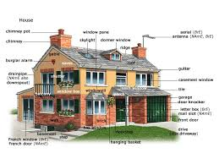
House vs. home?
The word “house” connotes the building you live in.
The word “home” connotes the people, safety and memories of family.

Slide 62
Connotation and Tone?
If you feel your relationship is strong and committed, what word would you choose to describe it?
dating someone
talking to someone
boyfriend/girlfriend
significant other

Slide 63
TWISt poetry analysis
Tone: What is the author's tone?
Word Choice: What particular word choice may be indicative of the author's feelings?
Imagery and Detail: Is there any specific imagery or use of detail that indicates the author's attitude or evokes a particular reaction from the reader?
Style: Does the author demonstrate any characteristic style that may help with interpretation?
Cognitive Poetic Devices (Figurative Language)
Auditory Poetic Devices (Rhyme/Rhythm)
Theme: What theme does the author present in the passage or poem?

Slide 64
TWIST

Slide 65
Connotation Practice
Those who are lonely and detached live in a house. Those who live with loved ones live in a home.
A mother and father have procreated. A ___ and ___ are loving parents.
Pushy salespeople are to be avoided. _____ salespeople make a lot of money.
I’m sick and tired of listening to politicians, but give me a good ____ any day of the week. He/She will get things done.

Slide 66
Same Love Connotation
What is the tone of this passage? Write an explication and provide evidence for words and lines that support.
Collaborative: Choose another artist and write 4-6 lines, sharing the same idea and connotation as “Same Love,” with a new set of word choice.
Example: Same Love vs. Born This Way
Write your new artist and your lyrics on a powerpoint to share
Highlight new word choice.
Individual: Develop a Poetic Word Lists of key words you find meaningful. You may use thesaurus.com on your phone. Record in your Journal.

Slide 67
Connotation Explication
Looking at the lyrics of ____________________’s song, “____________________, ” the author uses _________ connotations to convey a ___________ tone. This is an important tool in creating a ____________ mood, as the audience feels ___________ _____________________________________________. The artist uses words such as _____________ and ____________ to connote the idea that _____________________________________________________ __________________________________________________________. The lyrics, “______________________________________________ ____________________________________________” (___________)show ____________________________________________________.

Slide 68
TOPIC OPINION REASONS Ex: People with disadvantages must persevere through hardships in order to be victorious. __________________________ ________________________________ ___________________________
TOPIC OPINION REASONS Ex: People with disadvantages must persevere through hardships in order to be victorious. __________________________ ________________________________ ___________________________
TOPIC OPINION REASONS Ex: People with disadvantages must persevere through hardships in order to be victorious. __________________________ ________________________________ ___________________________
TOPIC OPINION REASONS Ex: People with disadvantages must persevere through hardships in order to be victorious. __________________________ ________________________________ ___________________________
TOPIC OPINION REASONS Ex: People with disadvantages must persevere through hardships in order to be victorious. __________________________ ________________________________ ___________________________
THESIS statement is 1 sentence defining the main argument of the body of writing.

Slide 69
GENRE Alternative / Country / Indie / Rock / Pop / R&B Hip Hop / Rap / Other _______________
GENRE Alternative / Country / Indie / Rock / Pop / R&B Hip Hop / Rap / Other _______________
GENRE Alternative / Country / Indie / Rock / Pop / R&B Hip Hop / Rap / Other _______________
GENRE Alternative / Country / Indie / Rock / Pop / R&B Hip Hop / Rap / Other _______________
GENRE Alternative / Country / Indie / Rock / Pop / R&B Hip Hop / Rap / Other _______________

Slide 70
Imagery
The pictures and images the writer creates in the mind of the reader.
Draws the five senses out:
taste
touch
smell
hear
see
Dreams Deferred:
https://www.youtube.com/watch?v=QrfLQpN2gZs

Slide 71
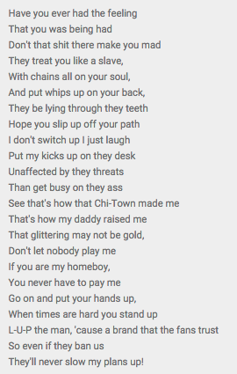
“The Show Must Go On” –Lupe
What Image does he present?
What is saying about his topic?
What’s his tone?
What’s the message?

Slide 72
Structure of Lyrics
Lyric poetry is a form of poetry which expresses personal emotions or feelings, typically spoken in the first person.
file://localhost/Users/reyannavance/Dropbox/Vance DVD/ELA 9 & Composition/Projects/Setlist/Song Writing Tips.pptx

Slide 73
Lyric Topics
Purpose: Construct a positive message to model for record labels.
Audience: Record label of choice
Popular topics of songs today + message it sends:

Slide 74
Leadership Wall
Chels/Lanna/Sam
5-6 categories
Rotation Calendar
Website
Layla/Dani/Chey
Select 4 categories
Assign new content
V-Day Memes
Stef/Hannah/Lucas/Sebast
Last year reflection
Designs (12-15)
Marketing Plan
Raffle
Charisse/Jewel/Layla
What? Why? 2/13 Friday
Marketing plan
Advisory Wall
Jenni/India/Jono
Jennifer.lopez5438@gmail.com
Display sign
Student highlight
Group highlight
Pics
Leadership Projects
Share out progress in 30 minutes

Slide 75
Lyric Structure \ Title _____________________________ Track _________________ Artist ________________
Structure (circle one) | Rhythm (Feet) | Rhyme Scheme | Lyrics
Verse Chorus Bridge |  |  | 1 ___________________________________________________________________ 2 ___________________________________________________________________ 3 ___________________________________________________________________ 4 ___________________________________________________________________
Verse Chorus Bridge |  |  | 1 ___________________________________________________________________ 2 ___________________________________________________________________ 3 ___________________________________________________________________ 4 ___________________________________________________________________
Verse Chorus Bridge |  |  | 1 ___________________________________________________________________ 2 ___________________________________________________________________ 3 ___________________________________________________________________ 4 ___________________________________________________________________
Verse Chorus Bridge |  |  | 1 ___________________________________________________________________ 2 ___________________________________________________________________ 3 ___________________________________________________________________ 4 ___________________________________________________________________
Verse Chorus Bridge |  |  | 1 ___________________________________________________________________ 2 ___________________________________________________________________ 3 ___________________________________________________________________ 4 ___________________________________________________________________

Slide 76
Lyric Structure \ Title _____________________________ Track _________________ Artist ________________
Character _____________________________
Plot:
IMAGERY
Pictures that are symbolic to me
Words List
Powerful words

Slide 77
Industry Groups
9:35
9:45
9:55
9:25
Rap/Hip Hop Lorenzo
Rachel Sp. Tatyana
Austin
Pop
James
Jessie
Remarie
Sierra
Rachel Seg.
Rock
Aaron
Nic
Alfonso
Arturo
Shayna
Rap/Hip Hop
Azali
Krystin
Makayla
Tiana
10:05
10:25
10:15
Indie
Jordin
Stephanie
Rachelle
Leiny
Steven
Alternative
Taylor
Melissa
Marta
Karen
Reed
Rap/Hip Hop
Vincent
Cynthia
Emily
Zionne

Slide 78
Industry Groups
1:35
1:45
1:55
2:05
Rap/Hip Hop: Brian
Karina
Ariana
Mariana
Melissa
Pop
Daisy G
Casey
Brittaney
Stephany
Rap/Hip Hop
Kaitlin
David
Hilario
Jose
Alternative/Indie
Cathy
Ana
Jackie
Melanie
2:15
2:25
2:35
2:45
Alternative
Diana
Samantha
Cristina
Alternative
Valerie M
Jannelli
Fernando
Daisy V
Alternative/Indie
Jacob
Danitza
Joselyn
Valerie G
Rap/Hip Hop
Jasmin
Jannely
Kimberly
Moises

Slide 79
Artist: _____________________________ Editor:__________________________
Imagery Feedback
 |  | Warm Feedback | Cool Feedback
Message (theme) of Song | The message or theme of the lyrics is (weak/strong or developed/underdeveloped) because: | Feedback: Line: | Feedback: Line:
 | Theme Concept Tone Audience Argument Positive Influence Verse Chorus
Imagery | The imagery of the lyrics is (weak/strong or developed/underdeveloped) because: | Feedback: Line: | Feedback: Line:
 | Metaphor Picture Audience Sight Sound Taste Touch Smell Detail

Slide 80
Artist: _____________________________ Editor:__________________________
Connotation Feedback
Artist Directions: Highlight 3 words that you feel need to be more powerful. Underline 3 words that you feel are powerful.
 |  | Warm Feedback | Cool Feedback
Suggestions | Maybe you could try…. Have you thought about….
 | Theme Verse/Chorus Tone Line Imagery Message/Theme Rhyme/Rhythm
Connotation | The connotation of the word ____ is (powerful/weak/strong) because: | Feedback: Word: _________________________ | Feedback: Word: _________________________
 | Imagery Detail Tone Negative Positive Suggests Connotes

Slide 81
Record Label Research
Prompt: Based on research your group conducts, write a letter to a record label in your genre that advocates for positive lyrics. Relate to the record label and build credibility by sharing your inspiration and your lyrics as examples.
Please see your Group Rubric.
Google Doc Group Research
*There will be a collaborative peer-grade based on the quality of your contributions accountability.

Slide 82
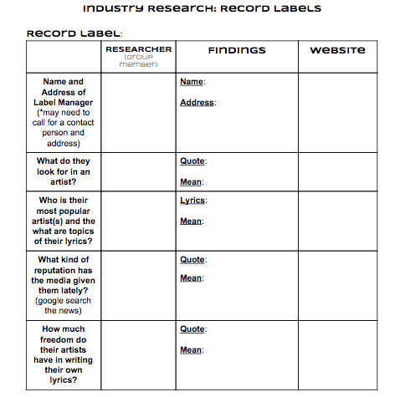

Slide 83
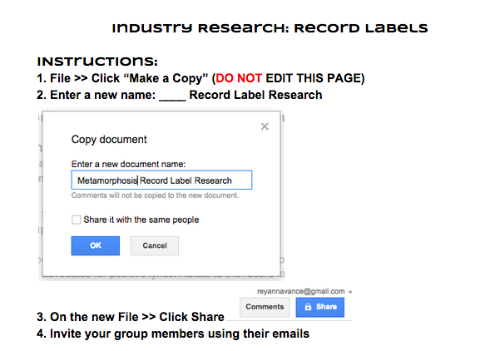

Slide 84
Present Letter Pitch
All group members must speak
Present Google Doc or PowerPoint
Share 2 interesting pieces of research about your record label
Your Argument: the “angle” you will take with your letter
I.E. You are a company that values artistic freedom. Sign on people that will use that to change the world.

Slide 85
Announcements
STUDIO signups during Collaborative Conference.
QUIZ Next Tues: study connotation/imagery paragraphs
Opportunity to re-do rhyme/rhythm paragraph to recover mastery grade

Slide 86
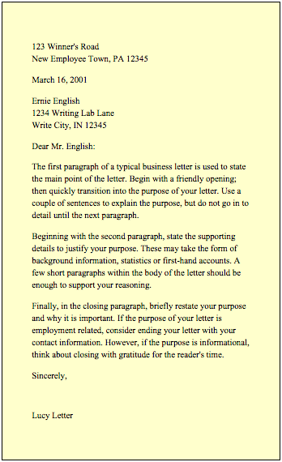
Purdue Owl: Letter Format
1) Sender’s Address
2) Date
3) Recipient’s Address
4) Greetings
5) Body
Include how and when they should contact you in the last line.
6) Salutation

Slide 87
THE SETLIST
Driving Question: How can we positively affect the music industry?
Prompt: Based on the research your group conducts, write a letter to a record label in your genre that advocates for positive messages in lyrics. Relate to the record label and build credibility by sharing your inspiration and your lyrics as examples of positive music.
Sender’s Name Letter format
Ms. Vance’s English 9 & Composition
12501 S Isis Ave.
Hawthorne, CA 90250
Date
Recipient’s address
Dear ________________ (manager’s name or “To whom it may concern”),
Paragraph 1: Persona ___________________
Introduce yourselves.
“We are students from Da Vinci Design”
“For the last __ weeks, we have been researching/investigating…”
Moment that creates relationship, credibility and persona.
“One group member described the moment she…”
“She forever remembers the feeling of... “
Paragraph 2: Audience ___________________
Relate to Record Label (similarities/what inspires you about their music)
“We were drawn to your record label because of your…”
“We appreciate your…”
Paragraph 3: Argument ___________________
Advocate for positive lyrics
“We encourage you to…”
Paragraph 4: Evidence ___________________
Prove there are artist who have positive lyrics and are successful (b record sales or evidence of popularity) OR prove negative messages hurt their business
“We look to ____ as a model for positive music, as he/she…”
“Although his/her music does not focus on sex, drugs or crime, they still sell ___ records a year. This means… “
Paragraph 5: Purpose ___________________
Share your desire for positive message and suggest your lyrics as examples.
“We urge you to join us in…”
“We have attached our own lyrics to demonstrate…”
Sincerely,
[leave space for handwritten signatures]
Group Member 1
Group Member 2 ...
1) _____________
2) _____________
3) _____________
4) _____________
5) _____________
6) _____________

Slide 88
Lyrics Explication
Prompt: Write an explication of your own lyrics. Introduce your lyrics with a an explanation of the message, purpose, audience and developed tone. Then, explicate the lyrics in the body by analyzing three of the following poetic devices: rhyme, rhythm, connotation of 2 words, or 1 example of imagery. Conclude by summarizing your tone and the message you intend to send. Free from error and employs academic language.
Introduction
Title and topic:
Message of your song:
Purpose of your song:
Thesis: By looking at the lyrics of “ __________________” it is evident that the __________ tone of my song is created through the _______, _______, and ______ (3 selected poetic device)s in order to develop the idea that __________________________ ________________________________________________________________________________________________________.
Explication 1: Rhyme/Rhythm/Connotation of 2 words/or Imagery
Topic Sentence:
Say (lyrical quote)
Mean:
Matter:
Transition:
Pre-Think
Choose (check) 3 of the following to use to explicate your lyrics:
☐ rhyme ☐ rhythm ☐ connotation of 2 words ☐ 1 example of imagery
Message of my song:
Tone of my song (How I Feel About My Topic):

Slide 89
III. Explication 2: Rhyme/Rhythm/Connotation of 2 words/or Imagery
Topic Sentence:
Say (lyrical quote)
Mean:
Matter:
Transition:
Explication 3: Rhyme/Rhythm/Connotation of 2 words/or Imagery
Topic Sentence:
Say (lyrical quote)
Mean:
Matter:
Transition:
Conclusion
Summarize 3 body paragraphs points
Summarize tone created
Summarize the message your song sengs
Call to Action: what do you want from your audience

Slide 90
Lyrics Explication
Prompt: Write an explication of your own lyrics. Introduce your lyrics with a an explanation of the message, purpose, audience and developed tone. Then, explicate the lyrics in the body by analyzing three of the following poetic devices: rhyme, rhythm, connotation of 2 words, or 1 example of imagery. Conclude by summarizing your tone and the message you intend to send. Free from error and employs academic language.
Introduction
Title and topic: The song titled, “ __________________,” addresses the issue of ________________________________________.
Message of your song: The song’s message encourages the audience to ______________________________________________.
Purpose of your song: The song is intended to __________________________________________________________________.
Thesis: By looking at the lyrics of “ __________________” it is evident that the __________ tone of my song is created through the _______, _______, and ______ (3 selected poetic device)s in order to develop the idea that __________________________ ________________________________________________________________________________________________________.
Explication 1: Rhyme
Topic Sentence: The rhyme of this song creates the ___________ tone by _____________________________________________.
Say (lyrical quote): The lines, “ _______________________________________” use rhyme to convey ______________________.
Mean: This means the audience feels __________________________________________________________________________.
Matter: The rhyme scheme, _________________________, helps the audience understand the idea that ___________________.
Transition: The rhyme develops the tone of this song, in addition to the connotation of the word choice.
Pre-Think
Choose (check) 3 of the following to use to explicate your lyrics:
☐ rhyme ☐ rhythm ☐ connotation of 2 words ☐ 1 example of imagery
Message of my song:
Tone of my song (How I Feel About My Topic):

Slide 91
Explication 2: Connotation
Topic Sentence: The word choice of the lyrics, “___________,” have a ___________ connotation which add to the _______ tone.
Say (lyrical quote): For example, the words “_________” and “__________” connote the feeling/idea of ___________________.
Mean: This means that the lyrics express the feeling of ____________________________________________________________.
Matter: The connotation of words reveal the meaning of the poem: _________________________________________________.
Transition: The word choice is another poetic device that creates the _________________ tone of the poem.
Conclusion
Summarize 2 body paragraphs points: The rhyme and connotation of words develop the ____________ tone of these lyrics.
Summarize tone created: The tones reveals the feeling ___________________________________________________________.
Summarize the message your song: It’s message is to _____________________________________________________________.
Call to Action: As an audience, this song should __________________________________________________________________.

Slide 92
Recording
Play your music on your phone
Record on SoundCloud and upload.

