Slide 2
My Example
What does the plaque include?
Is the plaque effective?
What needs to be added?
Should anything be deleted?

Slide 3
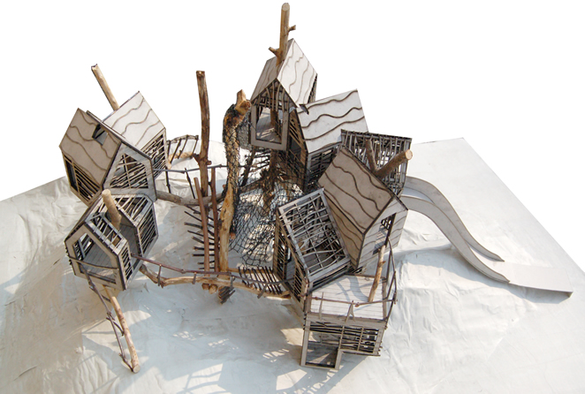

Slide 4
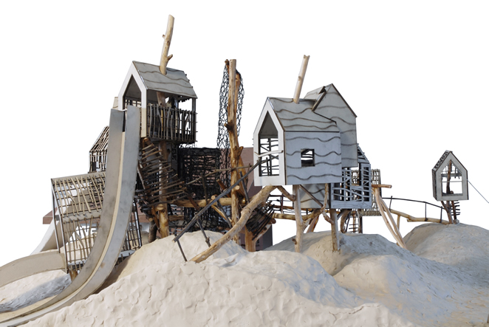

Slide 5
Reimagination Station Hawthorne, CA, March 2016 Medium Reclaimed wood, recycled metal, and modelling clay Dimensions (Full Scale) 10’11” at the highest point 20” wide 30” long Designers Ms. Haderlein Ms. Hannouche Ms. Love Mr. V | Drawing on inspiration from Ed Henry, an American born architect, Reimagination Station is a fully functional play structure made entirely of reclaimed, recycled, and reimagined materials. From the curved lines etched into the houses to the organic flow of the climbing apparatuses, the structure evokes a sense of whimsy and adventure appropriate for children of all ages. Ed Henry is famous for his use of reclaimed materials in the creation of modern and beautiful structures. We believe deeply, as does Mr. Henry, in an artist’s ability to reimagine old things and to make them beautiful and functional again. Our piece serves as an architecturally relevant reminder of society’s need to reduce our environmental impact. The play structure includes six interconnected houses joined by climbable wooden bridges and ladders, perfect for adventurous climbers. A recycled cargo net connects four of the main structures to a bridge made of wooden baseball bats in the center. Two slides, made of recycled cooking sheets, provide a quick exit from the structure’s highest points. Reimagination Station embodies a legacy of sustainability, adventure, and fun to be left for many generations to come.

Slide 6
Today’s Focus
Create the CONTENT of your plaque
You don’t need to worry about the design and formatting yet
Use the CONTENT checklist to help you
Type in a Google doc and SHARE WITH ME
Title of Doc:
LastName_Exhibition 17 Plaque

Slide 7
Draft of Plaque
Due tomorrow, Friday, March 31st, by 4:00 pm
Must share with me!

