Slide 1
English/Composition
Catalina Pera
Grade 9
Period 5-7

Slide 2
Essential Skill Topics
Essential Skill 8
(Literary Devices and Fictional Analysis)
Essential Skill 5
(Evidence)

Slide 3
Essential Skill 8: Literary Devices and Fictional Analysis

Slide 4
Characterization
Characterization
Direct
Descriptive Words
Tells about Character
Indirect
Reader’s Inferences
Character Traits Discovered through Thoughts and Actions
Shows Character

Slide 5
Characterization
Speech
Thoughts
Effects on others
Actions
Looks

Slide 6
Characterization
Speech—“I like it. Can’t wait to wear it!”
Thoughts—“I can’t back out of this now. All my friends will think I’m stupid, and they won’t like me anymore if I quit.”
Effects on others—“That was great! You’re a fabulous Juliet!”
Actions—“I said as I handed her my script.”
Looks—“…the wig wouldn’t have fit over my thick, brown hair anyway…”

Slide 7
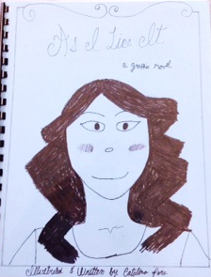
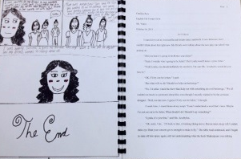
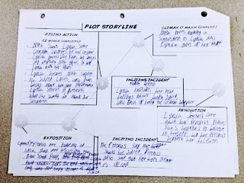
Application: Graphic Novel

Slide 8
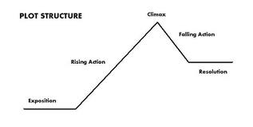
Basic Plot Structure

Slide 9
Hero’s Journey Plot Structure
Lunch
Marcy
Costume Design
Friends
New Play
Auditions for Juliet
Nina is Good Juliet
Final Lunch
Trades Roles
Believes in Herself

Slide 10
Changes
Original—Home was talking with friends after job switch
Update— “The next day at lunch, I wasn’t looking forward to my friends. The whole time, I was waiting for them to say something like…”

Slide 11
Essential Skill 5: Evidence

Slide 12
The Purpose of Evidence
Proves point
Supports main idea (thesis)
Convinces readers

Slide 13
Kinds of Persuasive Evidence
Pathos
Logos
Ethos

Slide 14
Application: TEDx Talk
Ethos: “Modern advertising seeks to create needs, not to fulfill them,’ reads a quote by Christopher Lasch.”
Pathos (Update): “Allowing these negative ads to continue is like encouraging cyber-bullying and saying it is harmless. Is that what we want? You don’t want to be bullied or verbally assaulted by people—so why are you letting beauty companies bully you into buying their products?”
Logos: “Among a sample of college women, 4o percent felt overweight when only 12 percent were actually too heavy…”

Slide 15
Reflection
Strengths
Writing
Analyzing other Works
Weaknesses
Helping Others
Editing Peer Papers

Slide 16
Thank you for Listening!
Do you have any questions?

